Slide 1


Presentation Title
Sohar University Research Conference (SURC9), 11-12 Feb 2026
Towards Impactful Contribution to the SDGs – Greening, Resilience, Transformative Technology, and Collaborative Partnerships
Your affiliation here
Sohar University – Oman
xxxx@xx.edu.om

Slide 2

The Title here
The slide contains here
we believe in shaping the leaders of tomorrow. We're committed to providing our students with a comprehensive education that not only prepares them for success in their chosen field but also instills in them the qualities of leadership, integrity, and social responsibility. From our exceptional faculty to our rigorous academic programs, we provide the resources and support you need to become a leader in your field and make a positive impact in the world.

Slide 3
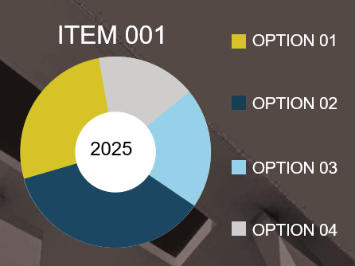
The Title here
The slide contains here
A comprehensive education develops:
  Leadership skills
  Integrity
  Social responsibility
Achieved through:
  Rigorous academic programs

Slide 4


